Slide 1

Object Oriented Programming with Java (Subject Code: BCS-403)
Unit 2
Lecture 17

Slide 2
Lecture 17
Byte Streams and Character Streams
Reading and Writing File in Java

Slide 3
Byte Streams and Character Streams
In Java the streams are used for input and output operations by allowing data to be read from or written to a source or destination.
Java offers two types of streams:
character streams
byte streams.

Slide 4
Character Streams
Character streams are designed to address character based records, which includes textual records inclusive of letters, digits, symbols, and other characters.
These streams are represented by way of training that quit with the phrase "Reader" or "Writer" of their names, inclusive of FileReader, BufferedReader, FileWriter, and BufferedWriter.
Character streams offer a convenient manner to read and write textual content-primarily based information due to the fact they mechanically manage character encoding and decoding.

Slide 5
Byte Streams
Byte streams are designed to deal with raw binary data, which includes all kinds of data, including characters, pictues, audio, and video.
These streams are represented through cclasses that cease with the word "InputStream" or "OutputStream" of their names,along with FileInputStream,BufferedInputStream, FileOutputStream and BufferedOutputStream.
Byte streams offer a low-stage interface for studying and writing character bytes or blocks of bytes.

Slide 6
They are normally used for coping with non-textual statistics, studying and writing files of their binary form, and running with network sockets.

Slide 7
Difference between Character Stream and Byte Stream in Java
Aspect | Character Streams | Byte Streams
Data Handling | Handle character-based data | Handle raw binary data
Representation | Classes end with "Reader" or "Writer" | Classes end with "InputStream" or "OutputStream"
Suitable for | Textual data, strings, human-readable info | Non-textual data, binary files, multimedia
Character Encoding | Automatic encoding and decoding | No encoding or decoding
Text vs non-Text data | Text-based data, strings | Binary data, images, audio, video

Slide 8
Performance | Additional conversion may impact performance | Efficient for handling large binary data
Handle Large Text Files | May impact performance due to encoding | Efficient, no encoding overhead
String Operations | Convenient methods for string operations | Not specifically designed for string operations
Convenience Methods | Higher-level abstractions for text data | Low-level interface for byte data
Reading Line by Line | Convenient methods for reading lines | Byte-oriented, no built-in line-reading methods
File Handling | Read/write text files | Read/write binary files

Slide 9
Java I/O
Java I/O (Input and Output) is used to process the input and produce the output based on the input.
Java uses the concept of stream to make I/O operation fast. The java.io package contains all the classes required for input and output operations.
Stream
A stream is a sequence of data. In Java a stream is composed of bytes. It's called a stream because it's like a stream of water that continues to flow.

Slide 10
In java, 3 streams are created for us automatically.
All these streams are attached with console.
1) System.out: standard output stream
2) System.in: standard input stream
3) System.err: standard error stream
Code to print output and error message to the console.
System.out.println("simple message");
System.err.println("error message");

Slide 11
OutputStream
Java application uses an output stream to write data to a destination, it may be a file,an array,peripheral device or socket.
InputStream
Java application uses an input stream to read data from a source, it may be a file,an array,peripheral device or socket.

Slide 12
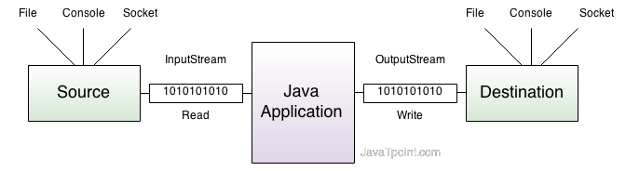
Working of Java OutputStream and InputStream

Slide 13
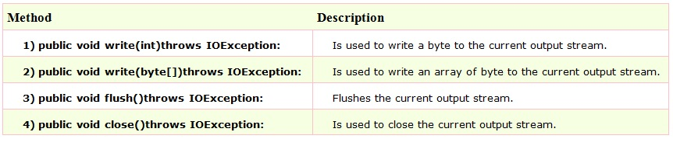
OutputStream class
OutputStream class is an abstract class. It is the super class of all classes representing an output stream of bytes. An output stream accepts output bytes and sends them to some sink.

Slide 14
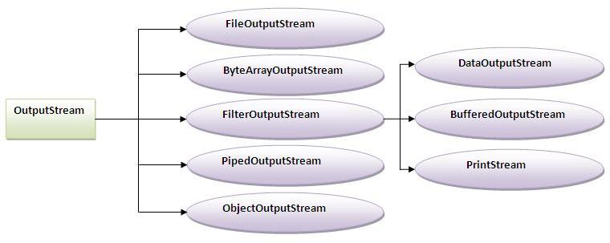

Slide 15
InputStream class
InputStream class is an abstract class. It is the super class of all classes representing an input stream of bytes.

Slide 16
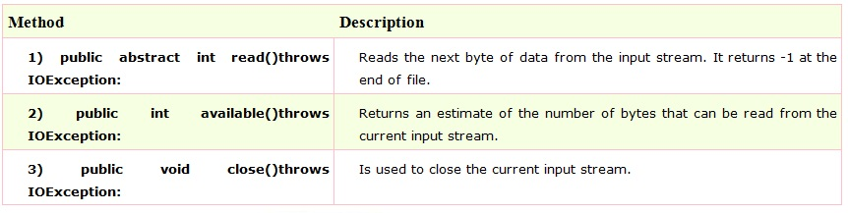
Commonly used methods of InputStream class

Slide 17
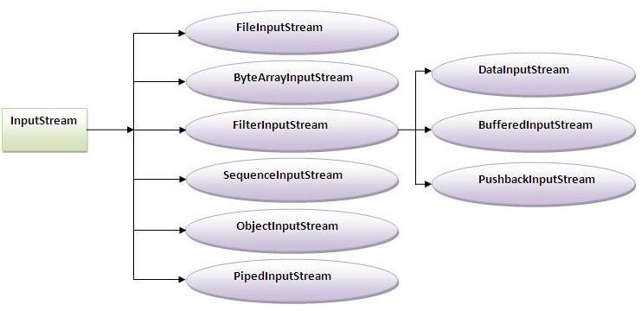

Slide 18
FileInputStream and FileOutputStream (File Handling)
In Java, FileInputStream and FileOutputStream classes are used to read and write data in file. In another words, they are used for file handling in java.
Java FileOutputStream class
Java FileOutputStream is an output stream for writing data to a file.
If you have to write primitive values then use FileOutputStream. Instead, for character-oriented data, prefer FileWriter.But you can write byte-oriented as well as character-oriented data.

Slide 19
import java.io.*;
class Test{
public static void main(String args[]){
try{
FileOutputstream fout=new FileOutputStream("abc.txt");
String s="Sachin Tendulkar is my favourite player";
byte b[]=s.getBytes();//converting string into byte array
fout.write(b);
fout.close();
System.out.println("success...");
}catch(Exception e){system.out.println(e);}
}
}
Output:success...

Slide 20
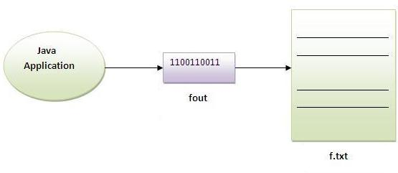

Slide 21
Java FileInputStream class
Java FileInputStream class obtains input bytes from a file.It is used for reading streams of raw bytes such as image data. For reading streams of characters, consider using FileReader.It should be used to read byte-oriented data for example to read image, audio, video etc.
import java.io.*;
class SimpleRead{
public static void main(String args[]){
try{
FileInputStream fin=new FileInputStream("abc.txt");
int i=0;
while((i=fin.read())!=-1){
System.out.println((char)i);
}
fin.close();
}catch(Exception e){system.out.println(e);}
} }
Output:Sachin is my favourite player.

Slide 22
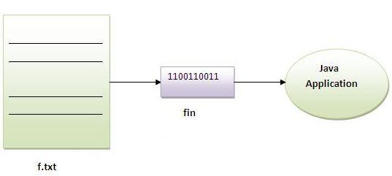

Slide 23
Reading the data of current java file and writing it into another file
import java.io.*;
class C{
public static void main(String args[])throws Exception{
FileInputStream fin=new FileInputStream("C.java");
FileOutputStream fout=new FileOutputStream("M.java");
int i=0;
while((i=fin.read())!=-1){
fout.write((byte)i);
}
fin.close();
}
}
We can read the data of any file using the FileInputStream class whether it is java file, image file, video file etc

